Slide 1
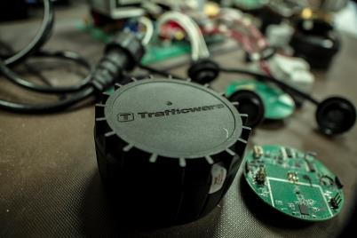
The Trafficware Pod
As a Means of Collecting Purdue High Resolution Data
The Pod
Engineer Training
The Pod
Bill Ische, Business Development Manager Chris Jannace, Detection Specialist 03 September 2015

Slide 2
Agenda
Components review
Installation Review
TSI review and planning considerations (Pod placement, spacing, antenna ranges)
Software programming
Intersection Design
Standard presence detection
Adaptive requirements
SPM requirements
ATMS Integration
Reports Available

Slide 3
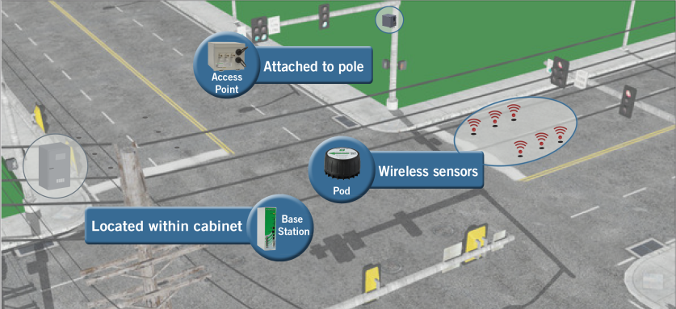
Components

Slide 4
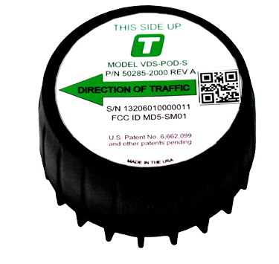
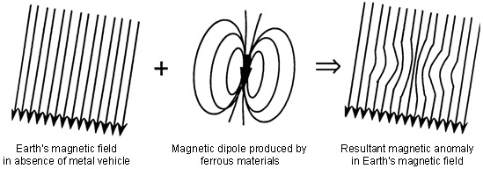
Components Pod Sensor
900 MHz Communication
6’ x 6’ Detection Area
10 Year Battery Life
700 detections per hour (24/7)

Slide 5
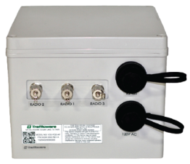
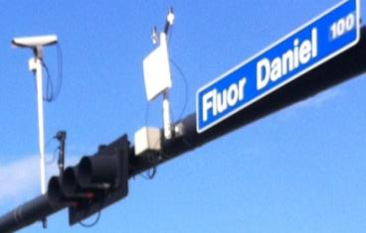
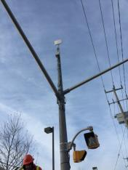
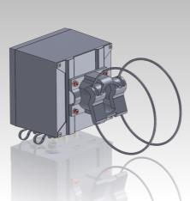
Components Access Point
120VAC
Wireless (internal) or Wired Communication
3 Radios (external)
Box designed to fit articulating style bracket (comes with Access Point kit)

Slide 6
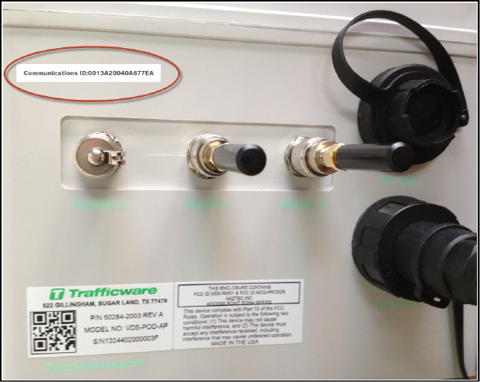
Software Programming Access Point
EIA-485 Cable to Lightning Suppression Panel (Cabinet)
Comm ID
RF Cable to Antennas
Radio 2
(Panel)
Radio 1
(Omni)
Radio 3
(Panel)
Serial
Number
16 awg Cable (Power) to Power Panel (Cabinet)

Slide 7
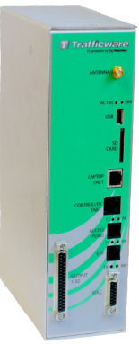
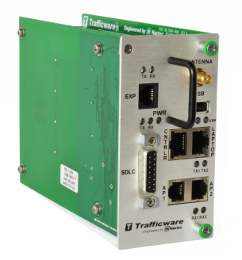
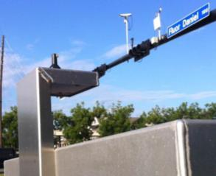
Components Base Station
ZigBee standard compliant encryption used between Base Station and Access Point
Can communicate effectively with two Access Points
Browser-based GUI (You own the Base Station, You own the GUI)
SDLC or parallel wiring connection to controller / cabinet based on configuration

Slide 8
Software Programming Base Station
Cable to Expansion Cards (if not SDLC)
Antenna to top of Cabinet
Serial Number (Sticker)
Cable to Laptop
Cable to Switch / Cell Modem
Cable to Access Point (thru EIA-485 Lightning Suppression Panel
Cable to Controller

Slide 9
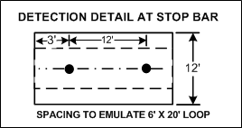
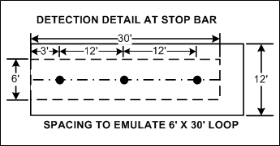
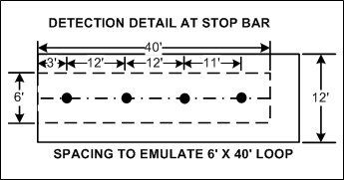
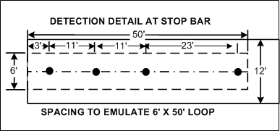
Detection Zones Pod Spacing

Slide 10
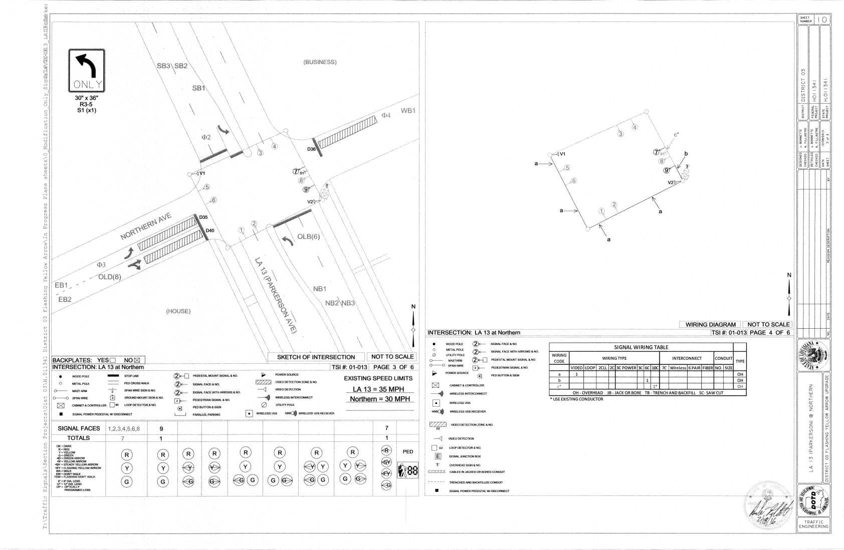
TSI Review & Planning Considerations
*** Go to Google Earth to review ranges

Slide 11
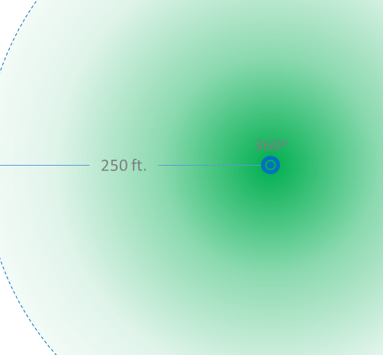
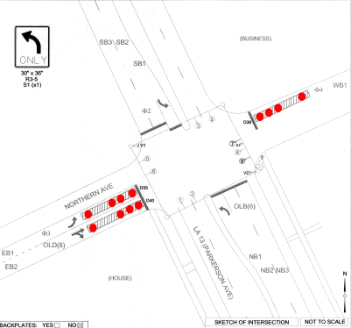
TSI Review & Planning Considerations

Slide 12
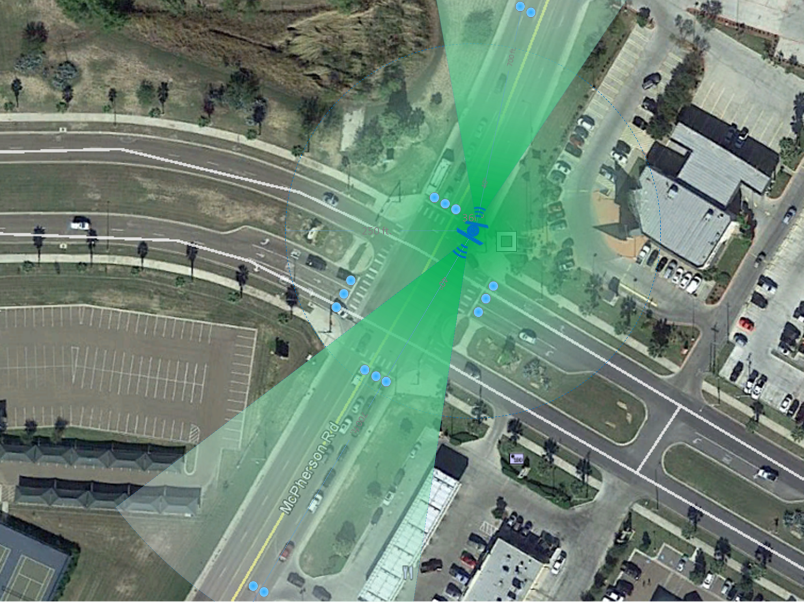
TSI Review & Planning Considerations
Antennas
AP Placement
Which Radio?

Slide 13
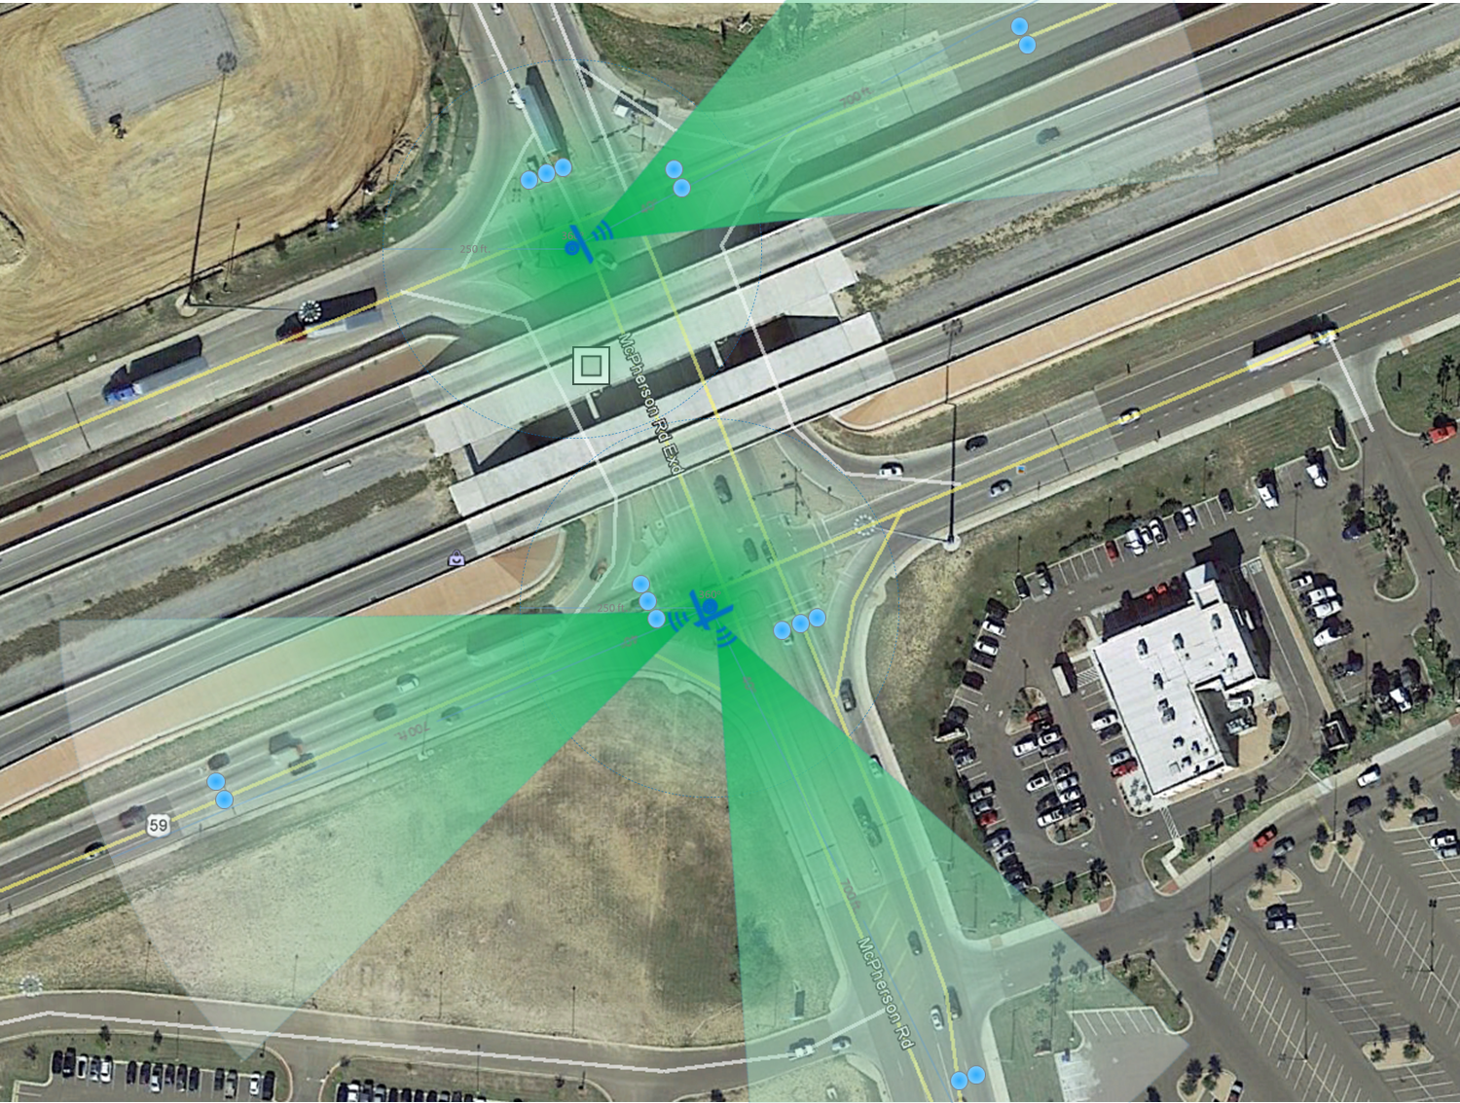
TSI Review & Planning Considerations
Antennas
2 APs
Wired
Wireless
Off Ramp Zone Options

Slide 14
TSI Review & Planning Considerations Ex. 2
Up to 30 high-volume Pods per Radio
Add Omni or Panel Antenna

Slide 15
Software Programming Computer Set-up

Slide 16
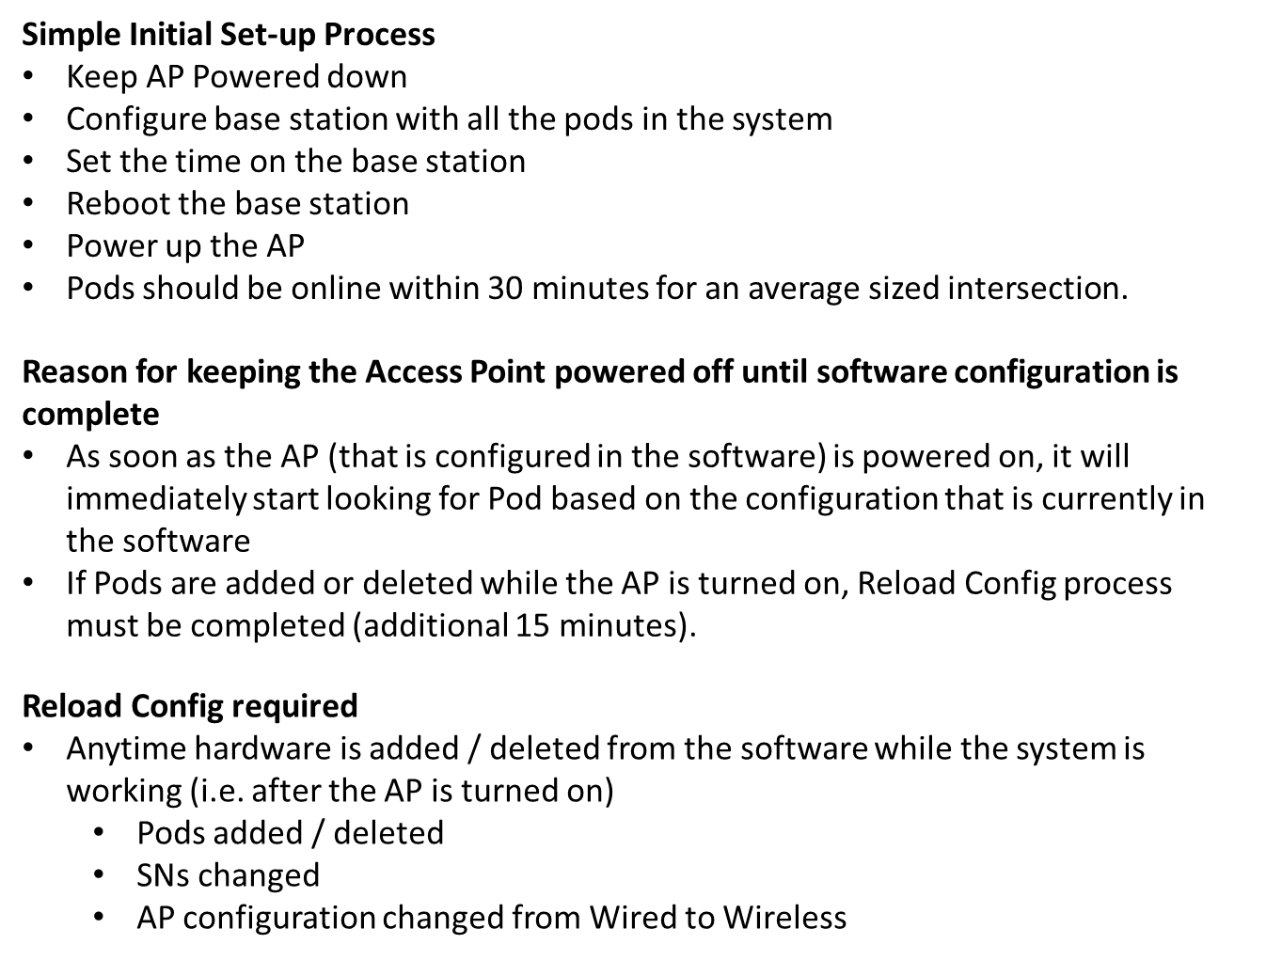
Software Programming Set-up Tips

Slide 17
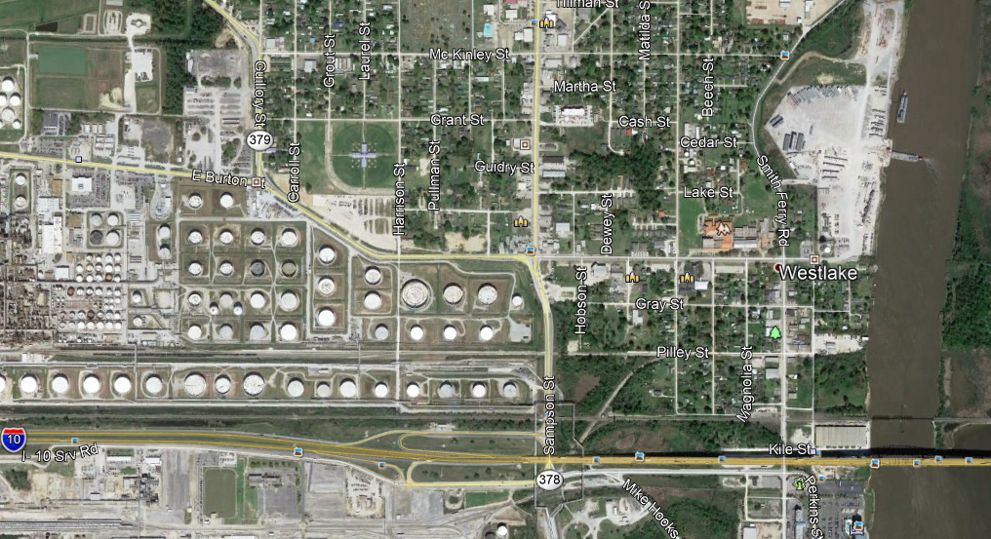
Corridor Considerations NetID / Access Point
Explanation of NetID effects on Access Point Radios
NetID: 5
NetID: 1
NetID: 4
NetID: 2
NetID: 3

Slide 18
Changes – Requirements & Time Considerations
Reload Config
System Reboot – loss of detection for minute
15 minute process (+Pod sync) – constant calls
When Required
Base Station NetID change
Access Point replacement
Access Point Communication change
Pod replacement
Pod Add / Delete
Pod Radio change

Slide 19
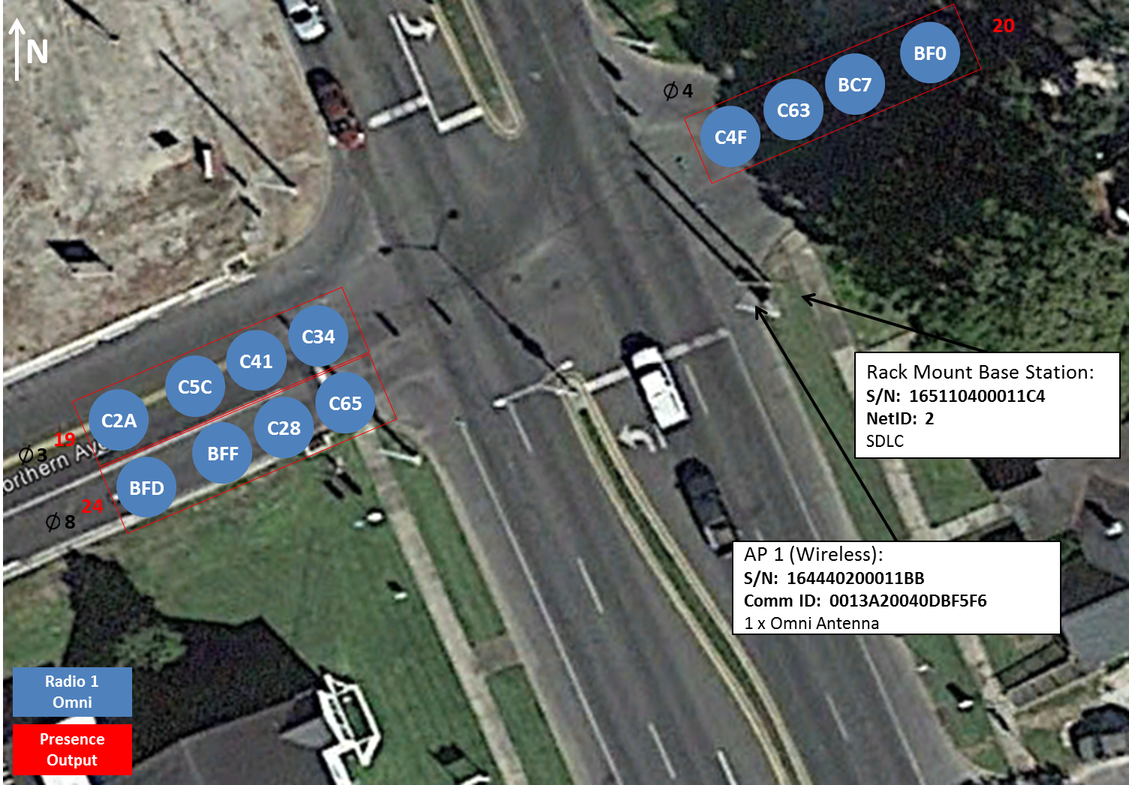
Intersection Design Presence

Slide 20
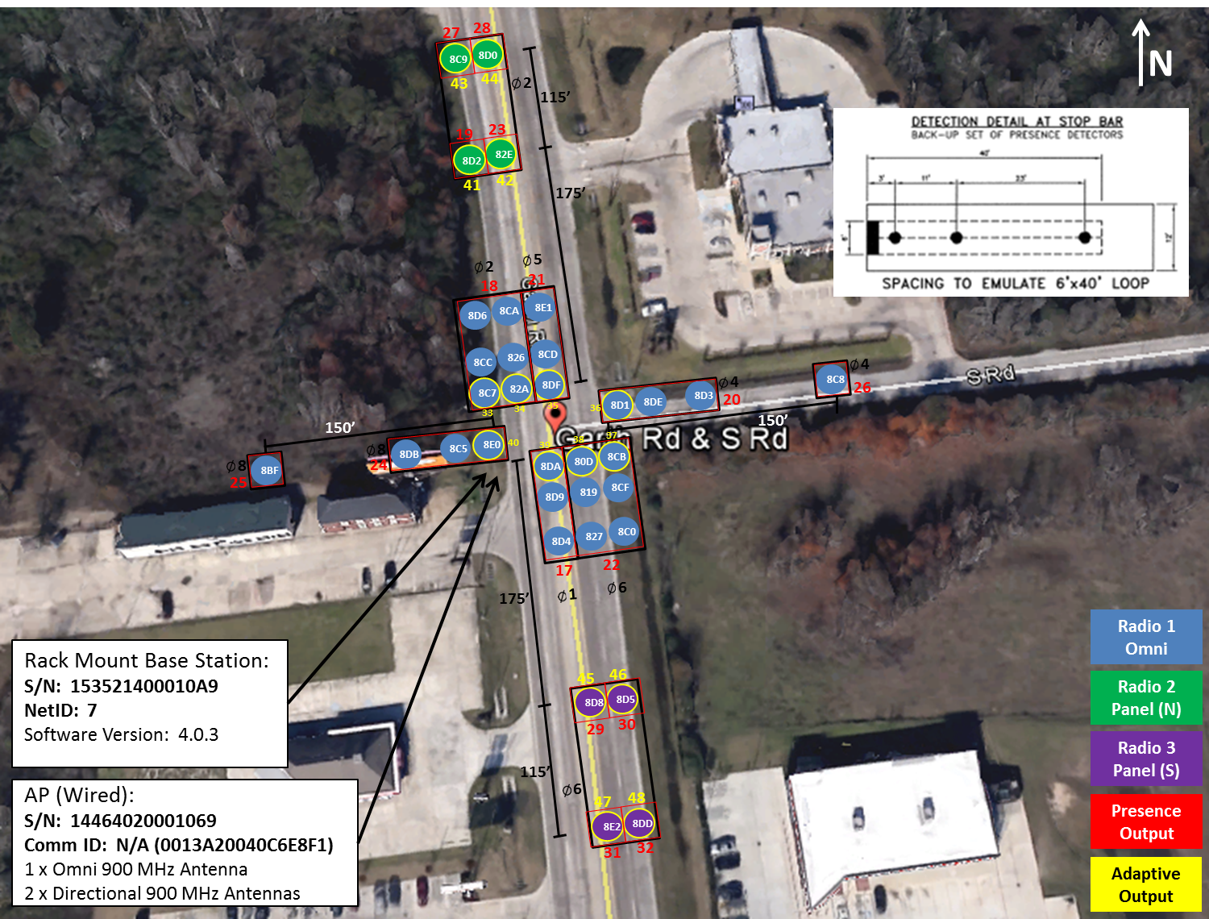
Intersection Design Adaptive
Output requirements
Cloning

Slide 21
Signal Performance Measures
SYSTEM
CONTROL
LOCAL CONTROL
DETECTION
COMMUNICATION

Slide 22
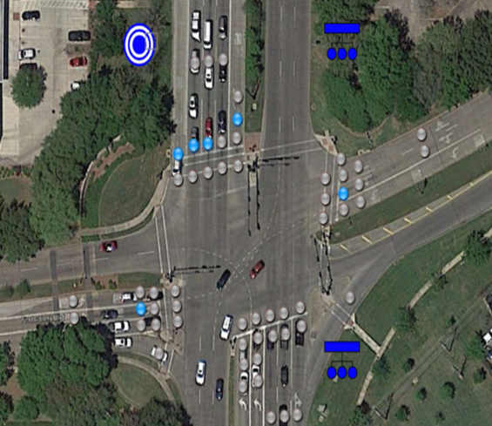
Detection Requirements SPM
STOP BAR
RED LIGHT MONITOR
TURNING MOVEMENT
ADVANCE

Slide 23
Detection Requirements (Cont.) SPM
 | Advance Detector | Red Light Monitor (RLM) | Stop bar Detector | Turning Movement Count (TMC)
Approach Delay | ✓
Approach Volume | ✓
Arrivals on Red | ✓
Pedestrian Delay
Preemption Details
Purdue Coordination Diagram | ✓
Purdue Phase Termination
Purdue Split Failure |  |  | ✓
Split Monitor
Turning Movement Counts |  |  |  | ✓
Yellow and Red Actuations |  | ✓

Slide 24
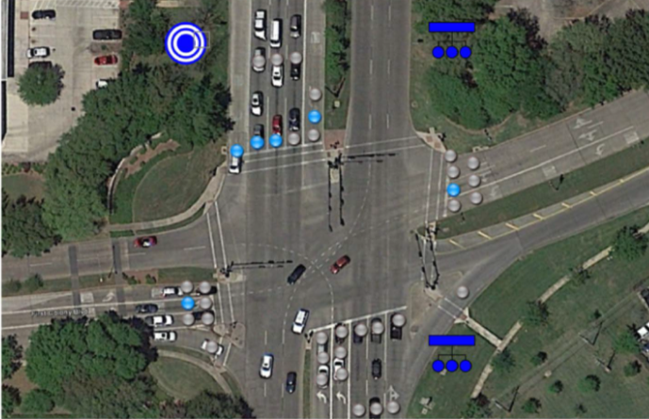
Intersection Design Example SPM
Minimum Requirements

Slide 25
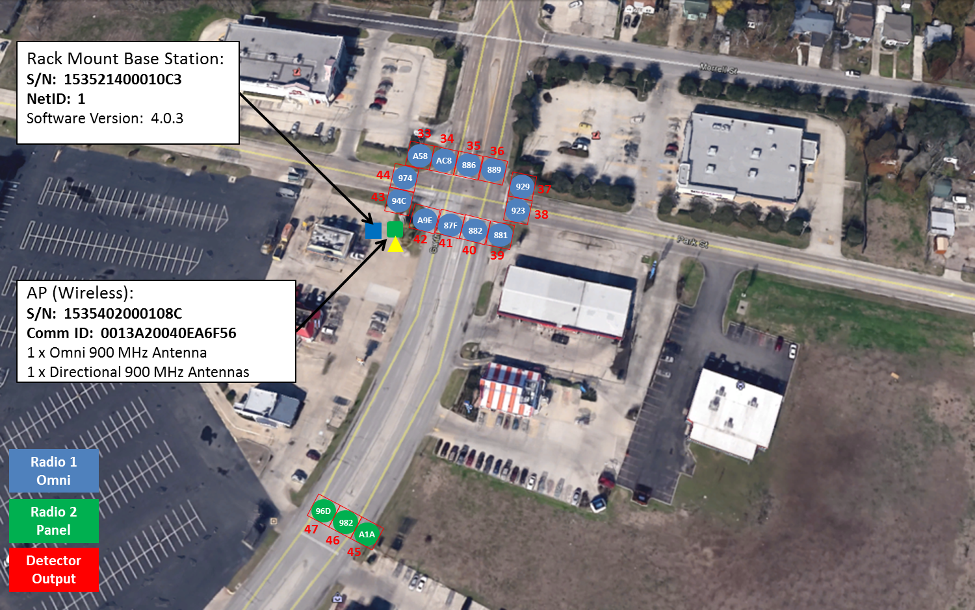
Intersection Design Example SPM
Software Design

Slide 26
New Capabilities
[Preempt] – Flush / Flasher
Speed
Wrong Way Detection

Slide 27
Reports Available
ATMS Individual Detectors
Volume / Occupancy
Events

Slide 28
Contact Information
Chris Jannace, Detection Specialist
ChrisJannace@trafficware.com
(O) 281-240-7233 x309
(C) 626-261-0875
Areas of Responsibility:
Louisiana
Mississippi
Texas
Arkansas
Oklahoma
New Mexico
Hawaii

